Slide 1

Contextual Topic Modeling for Dialog Systems
from Alexa, Amazon
AI 2-2
한건수 연구원
2019. 6. 11
Copyright© 2018 TmaxData. All Rights Reserved.

Slide 2
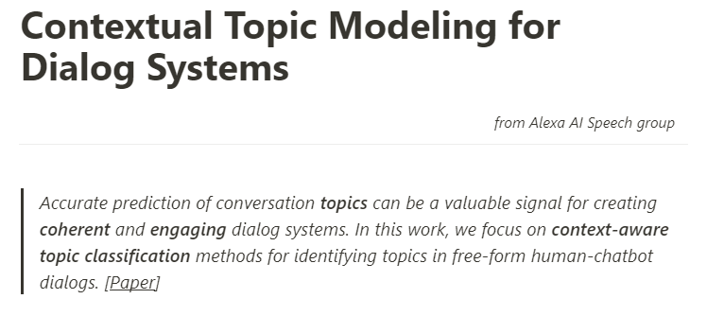

Slide 3
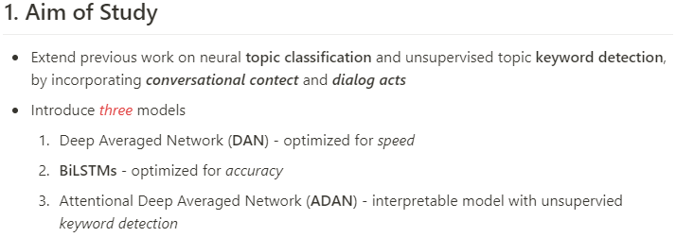

Slide 4
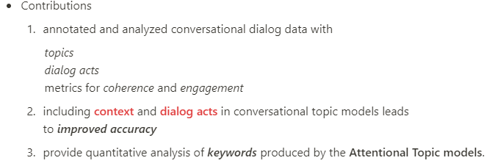
Contributions

Slide 5
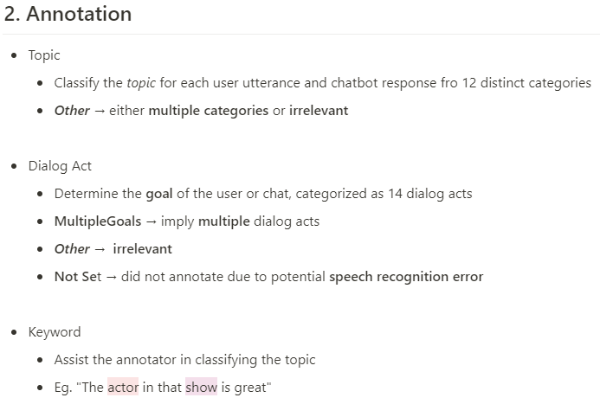
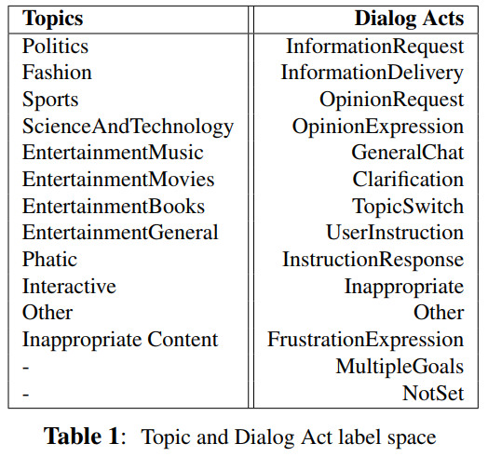
Topic

Slide 6
Dialog Act

Slide 7
Keyword

Slide 8
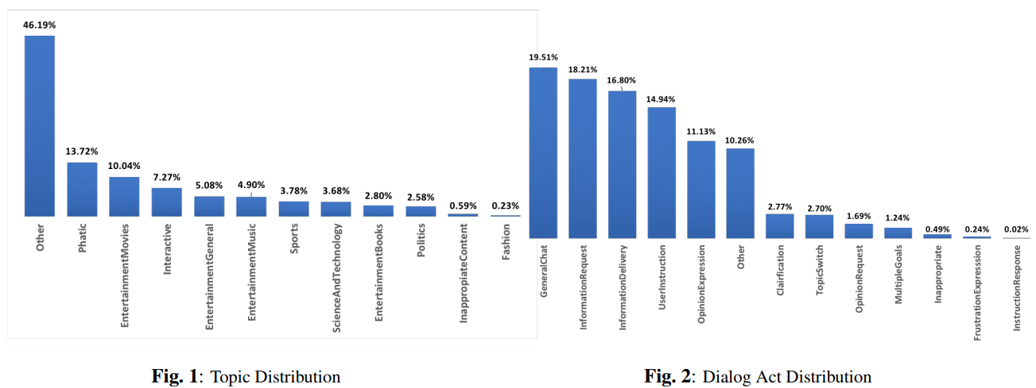
Topic and Dialog Act Distribution

Slide 9
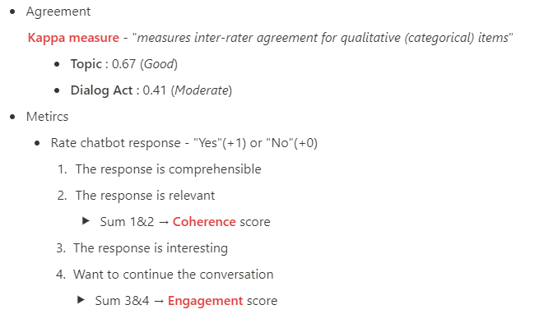

Slide 10
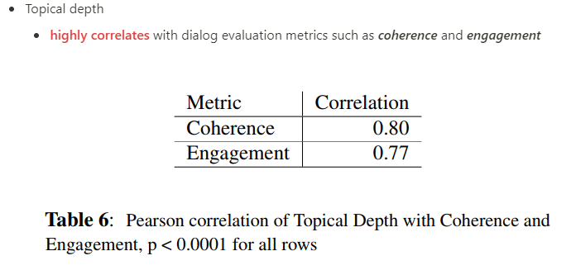
Topical Depth

Slide 11

Data

Slide 12
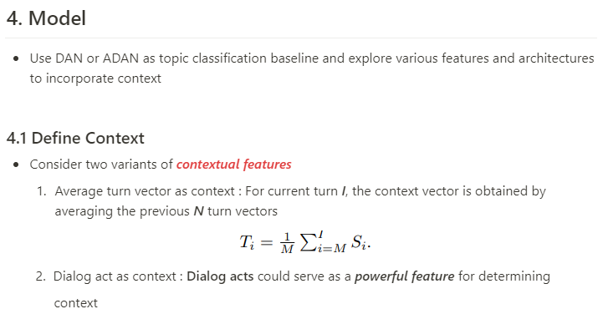
Model

Slide 13
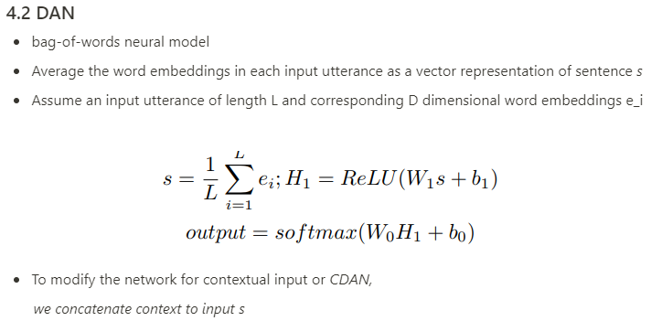
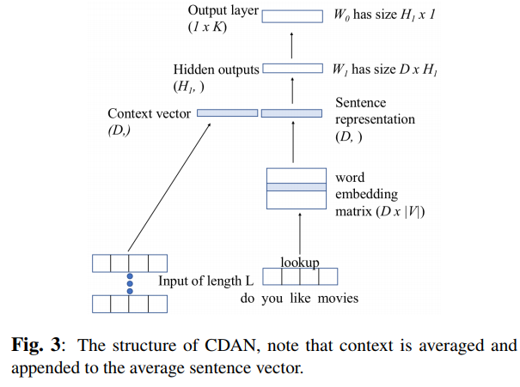
DAN

Slide 14
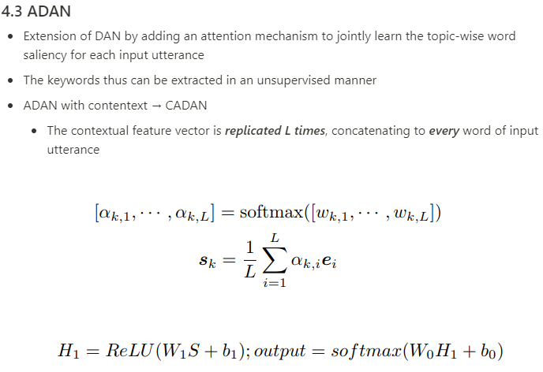
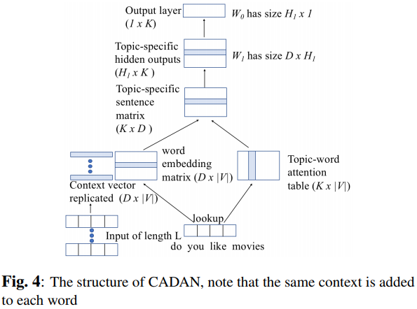
ADAN

Slide 15
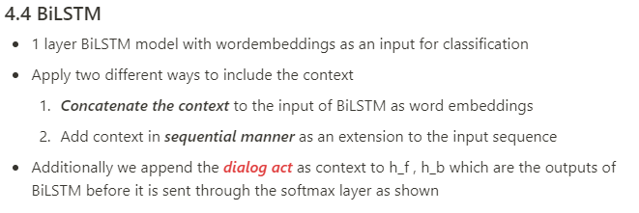
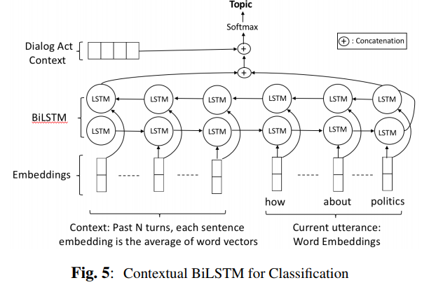
BiLSTM

Slide 16
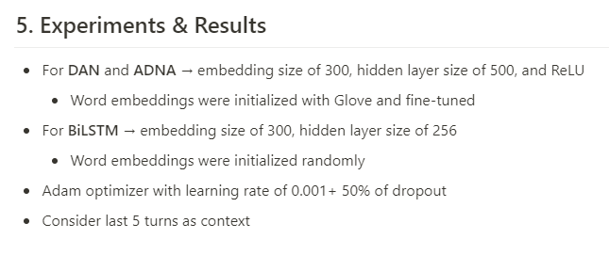
Result

Slide 17
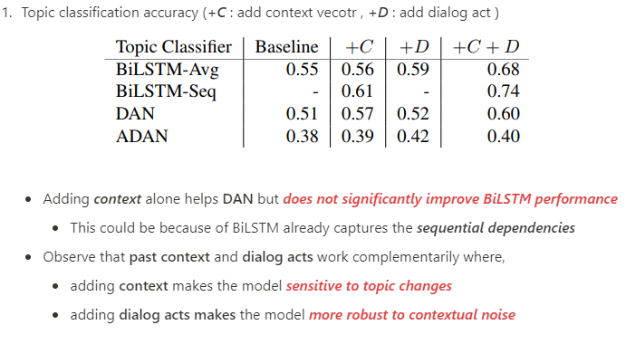
Result

Slide 18
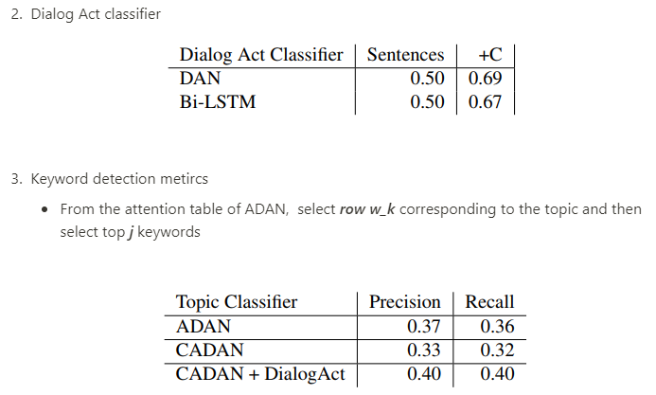
Result

Slide 19
감사합니다

